Slide 1
Online Citation Generator
By Cameron Block

Slide 2
Introduction
I thought an online citation generator would be worth while pursuing, because not all Citation Generators are as updated as others, and I wanted to at least explore creating one of my own. This one only aims at citing books, but other database tables and classes could theoretically be added.

Slide 3
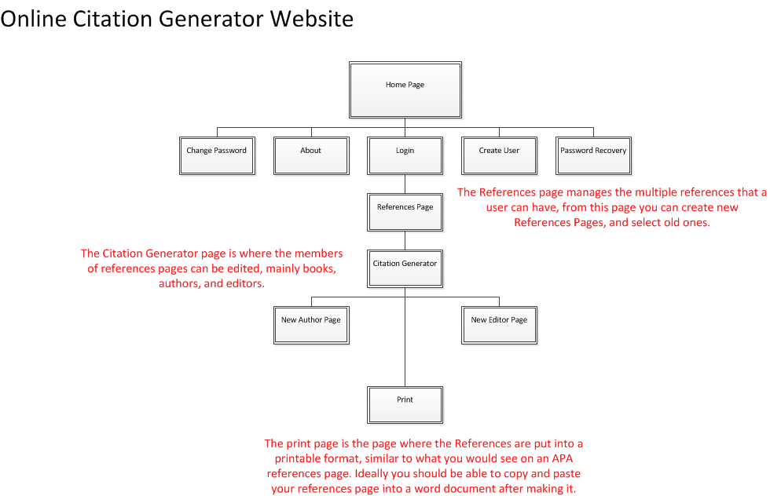
Overview
Notes:
The homepage is the main page, and the Login page allows you to access the Citation part of the web site. The References page allows you to select from multiple different references pages, The Citation Generator allows you to edit the data of references pages, and the Print page is where the APA References page can be printed. I would recommend actually copy and paisting the data there into a word document as it would make the final product look nicer.

Slide 4
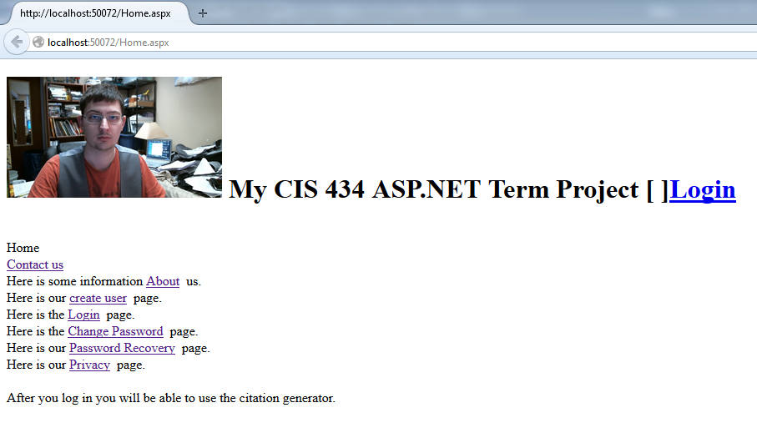
The Home page
Notes:
The home page links to the links shown. Every page uses a master page which includes a picture of me, a title, a login name control, and a login control.

Slide 5
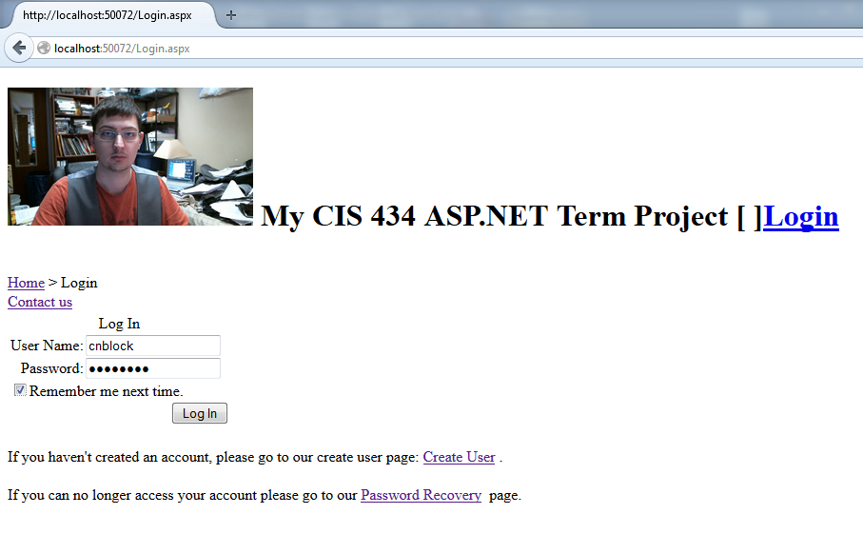
Login Page
Notes:
The login page forwards a user directly to the References part of the web site.

Slide 6
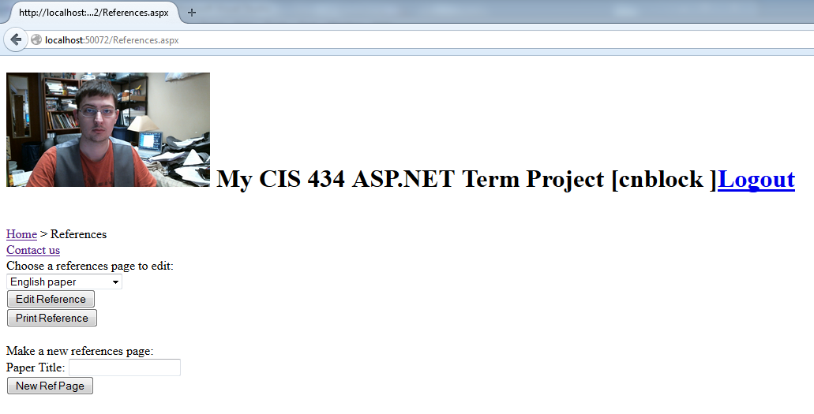
References Page
Notes:
On the References page, there is a drop down list for the current users different references pages. A reference page can be seleced and edited, or printed. New References pages can also be created using this page.

Slide 7
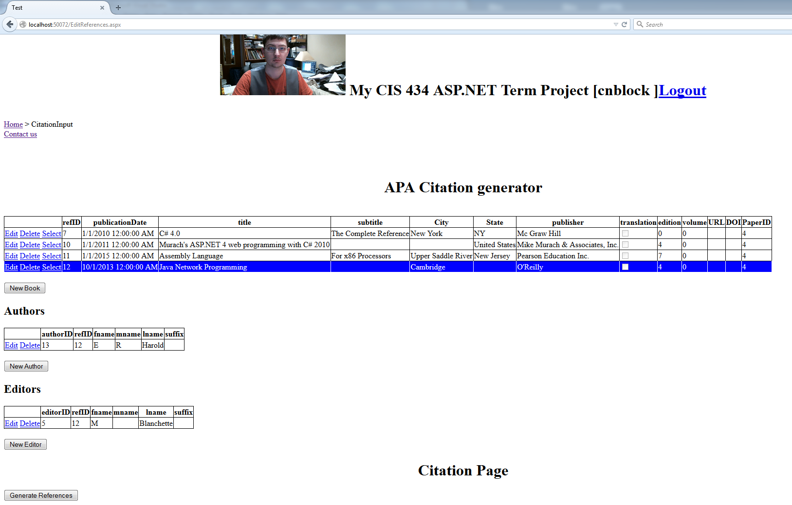
Edit References
Notes:
The Edit References page allows the user to create new books, with new authors and editors. There can be multiple Authors and Editors per book, so the Authors, Editors, and Books are represented as their own interlinking tables. The Generate References button at the bottom of the page forwards you to the print page where you can print a representation of your references page.

Slide 8
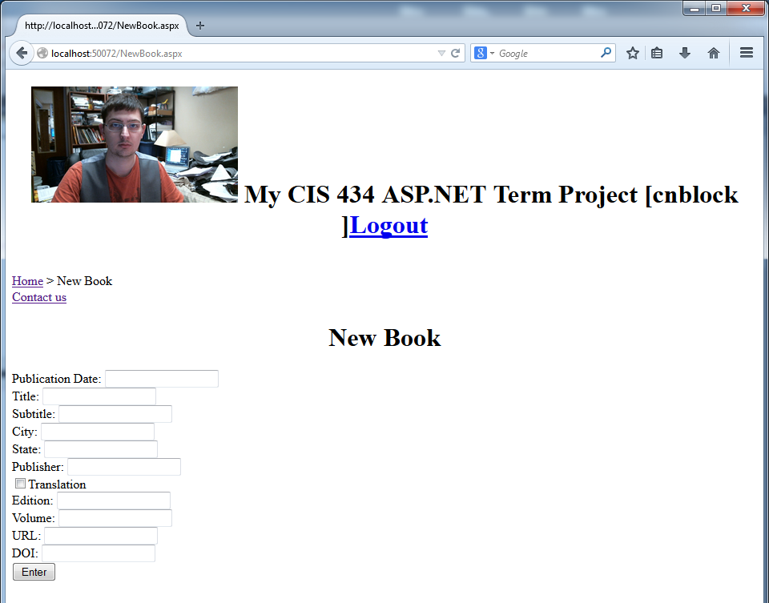
New Book Page
Notes:
The New Book page includes text boxes for all the fields in the book table. This page includes a compare validator and some required field validators as well as a validation summary componenet.

Slide 9
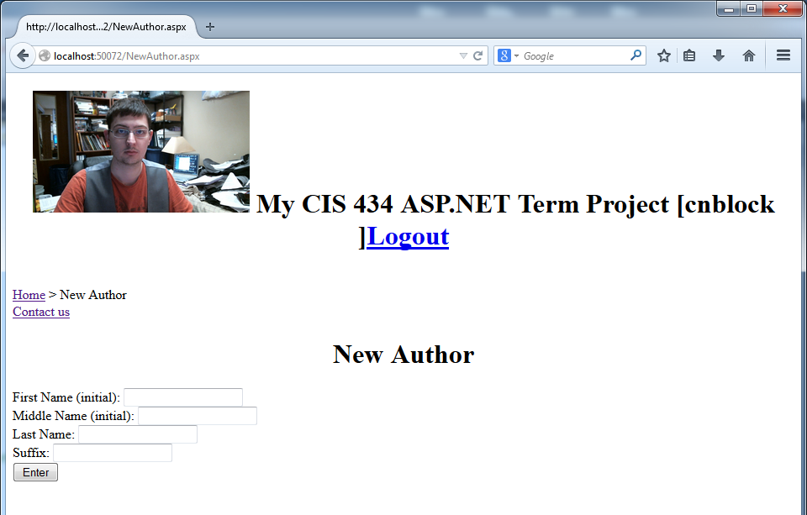
New Author Page
Notes:
Has one required field validator.

Slide 10

New Editor Page
Notes:
Has one required field validator.

Slide 11
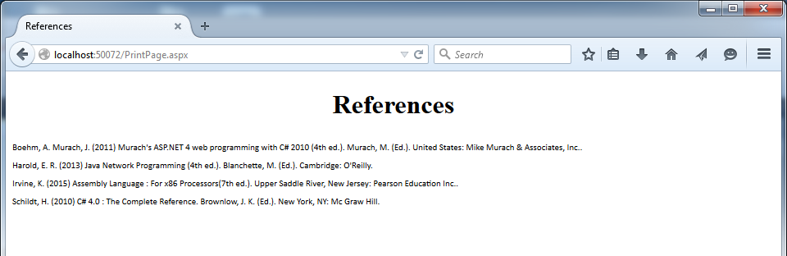
Print Page
Notes:
The database data is read into a specialized book class that allows for comparison, sorting, and string representation. An additional operation that is part of the Print Page allows for sequencing to be incorporated, for instance if there is an author that has published multiple works, the works can be differentiated from each other with an a, b, c, etc next to the date as per APA standard. The classes are also smart enough to know when to print the editors first, the authors first, or the title first.

Slide 12
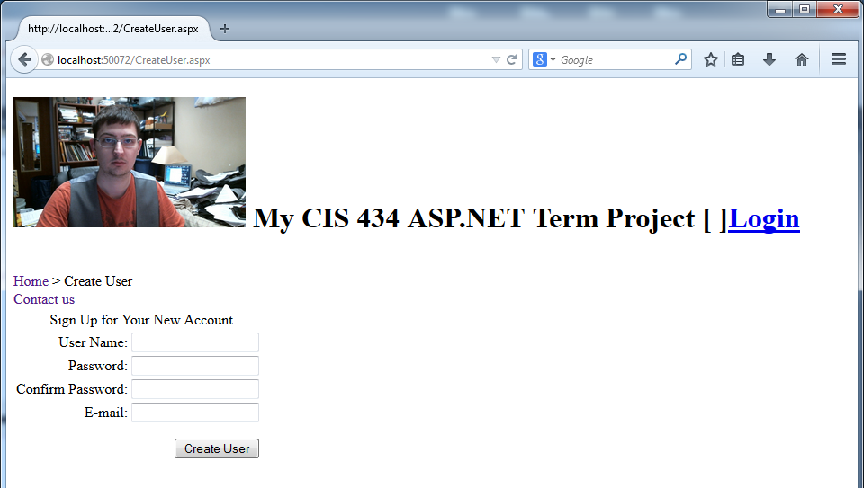
Create User Page

Slide 13
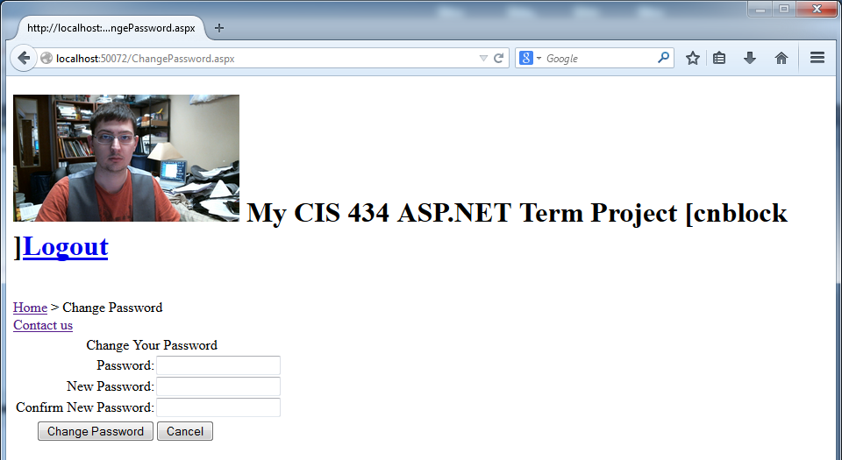
Change Password Page

Slide 14
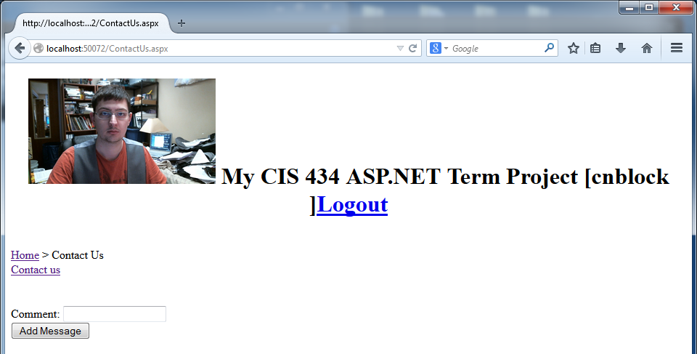
Contact Us Page
Notes:
The contact us page is basically a shout box, it does forward to a thank you page which takes into account user text, for instance if the user enters the words damn, or darn in the comment box the text changes. I thought a shout box with an hour value of 24 hours would be sufficient, because I didn’t want to have a mail account that gets loads of unsolicited spam.

Slide 15
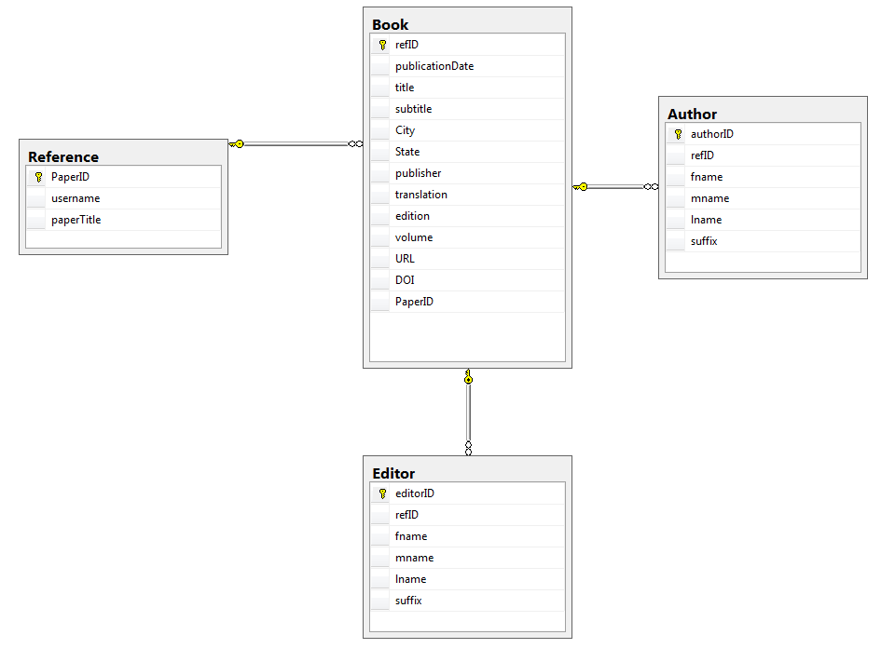
The Database
Notes:
Each book can have multiple authors and editors, therefore they need their own table. The Book table holds all other reference data used by the citation generator. The Reference table is used to associate books with a particular reference page.

Slide 16
Lessons Learned
If you have to modify a database later in a project Visual Studio will not let your new columns show up until you delete the old data.
Displaying hierarchical/linked tables requires multiple Grid/List Views, or an SQL join.
If a grid view cell is not visible, then it’s text property cannot be accessed.
Choosing a different form of application would have met more of the requirements.
Read only control fields do not update to the database, are replaced by nulls.

Slide 17
Conclusion
This is a good start on a citation generator, It could use some modifications for real world use, but I believe was troublesome enough to qualify for academic use.

